Slide 1


Felipe Valenzuela
14-06-2025

Slide 2

Outline
Executive Summary
Introduction
Methodology
Results
Conclusion

Slide 3
Executive Summary
The report will present an analysis of rocket launch data from the U.S. company SpaceX. Initially a data cleaning was performed, which consists of eliminating empty data and selecting variables relevant to our target variable. Then it was analyzed with SQL queries to finish with training classification models such as: decision tree, knn, svm and logistic regression. As a conclusion, the models generally performed well, with 83% accuracy for svm, logistic regression and knn, while the decision tree obtained 73%. As a result, the least recommended model for the data analyzed was decision tree, compared to the others.

Slide 4
Introduction
The topic to be analyzed is about the results and data of rocket launches of the US company SpaceX. The data collected deals with booster version, flight number, time, landing, refusal, etc. The question to pose for the analysis is that we can observe with the data provided to reduce costs in rocket launches for the company SpaceY.

Slide 5

Section 1

Slide 6
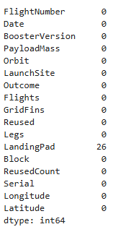
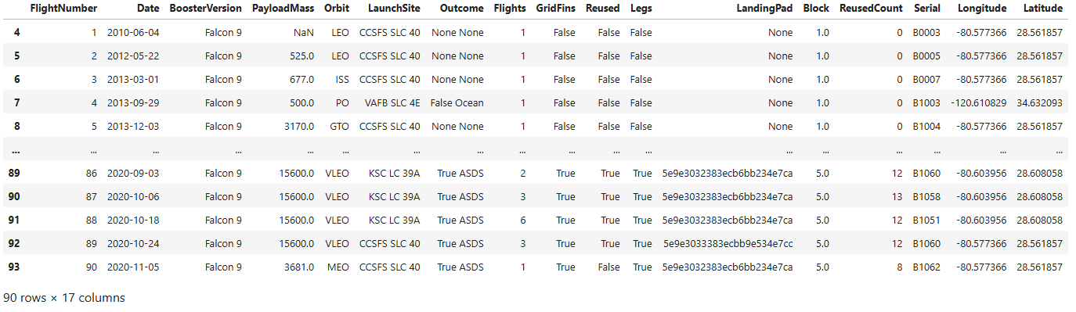
Data Collection – SpaceX API

Slide 7
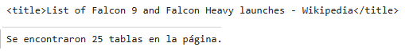
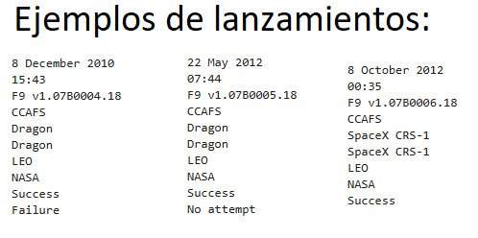
Data Collection - Scraping

Slide 8
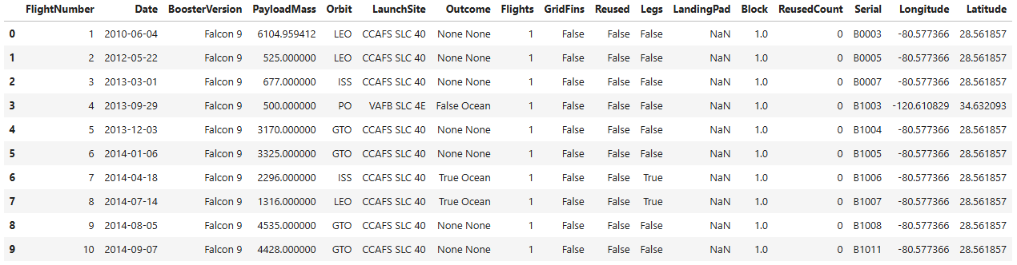
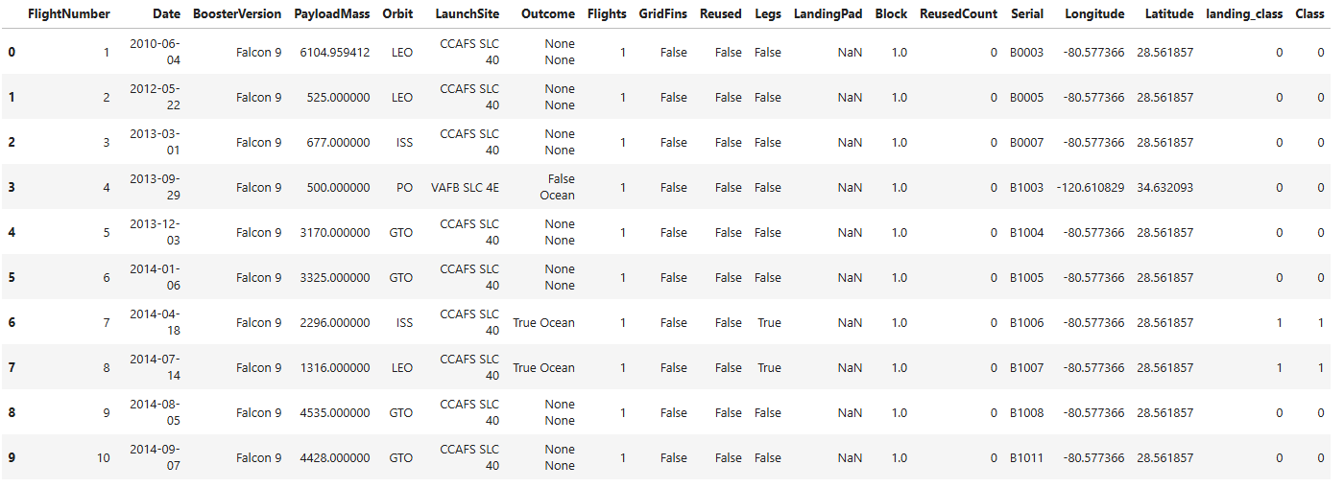
Data Wrangling
Datos iniciales
Datos limpiados
% de aterrizaje exitoso luego de analisis

Slide 9
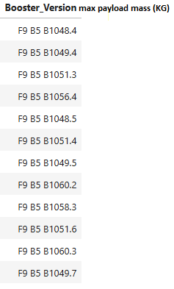
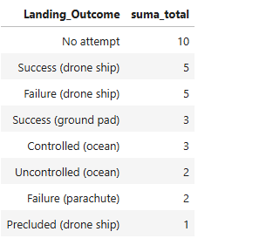
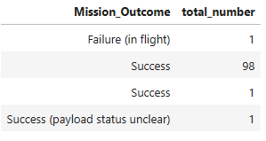
EDA with Data Visualization

Slide 10
Build an Interactive Map with Folium
Summarize what map objects such as markers, circles, lines, etc. you created and added to a folium map
Explain why you added those objects
Add the GitHub URL of your completed interactive map with Folium map, as an external reference and peer-review purpose

Slide 11
Build a Dashboard with Plotly Dash
Summarize what plots/graphs and interactions you have added to a dashboard
Explain why you added those plots and interactions
Add the GitHub URL of your completed Plotly Dash lab, as an external reference and peer-review purpose

Slide 12
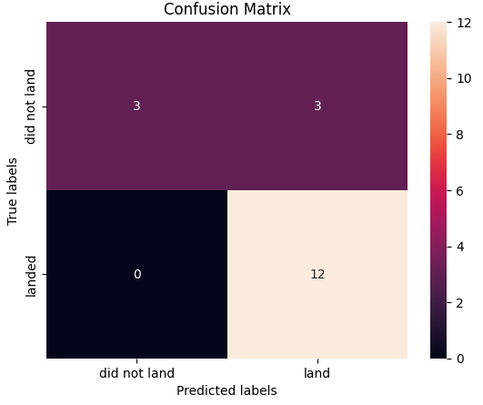
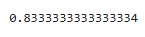
Predictive Analysis (Classification)
Logistic regression:
Accuracy:

Slide 13
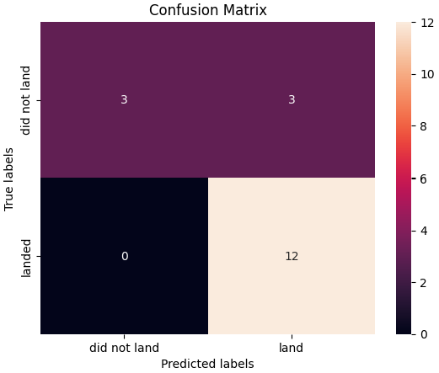
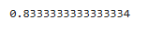
Predictive Analysis (Classification)
Svm:
Accuracy:

Slide 14
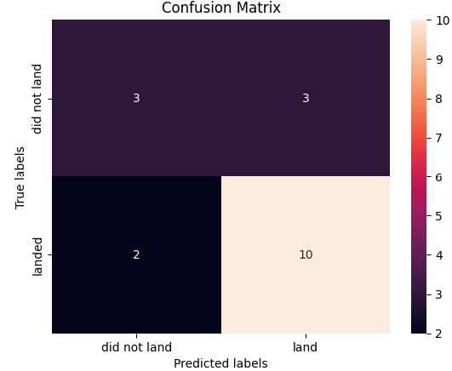
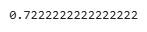
Predictive Analysis (Classification)
decision tree:
Accuracy

Slide 15

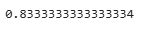
Predictive Analysis (Classification)
Accuracy
Knn:

Slide 16
Conclusions
As conclusions it can be observed that of the models: Logistic regression, Decision tree, svm and knn the ones with the best results were: Logistic regression, svm and knn with 83% accuracy.On the other hand, Decision tree had the worst performance of the 4 models, with 73% accuracy.

Slide 17


